Slide 1

Predicting Housing Prices in Ames, Iowa
August, 27, 2018
| Christopher Manley

Slide 2
Goals
Build a regression model that works with at least some degree of accuracy.
Learn about the process of building and refining a model.

Slide 3
Methodology
I approached this problem making several assumptions based on intuition
I cleaned the data based on variables I thought I would use
Used correlation to sale price to select my predictors
Used interaction term for Square Footage and Overall Quality
Combined columns for full baths into total full baths and columns for half baths into total half baths
Attempted to incorporate location into my model
Grouped columns that represented years (year sold, year remodeled, etc. into groups based on 25th , median and 75th percentiles, assigning ordinal values to each**

Slide 4
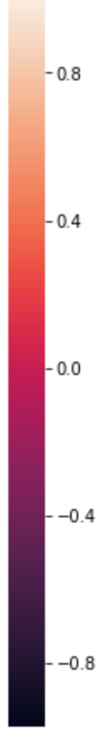
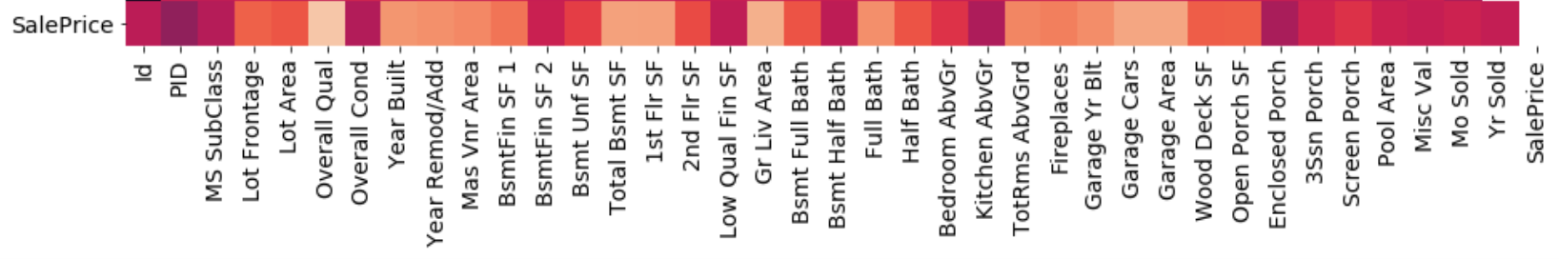
Heatmap correlation with sale price.

Slide 5
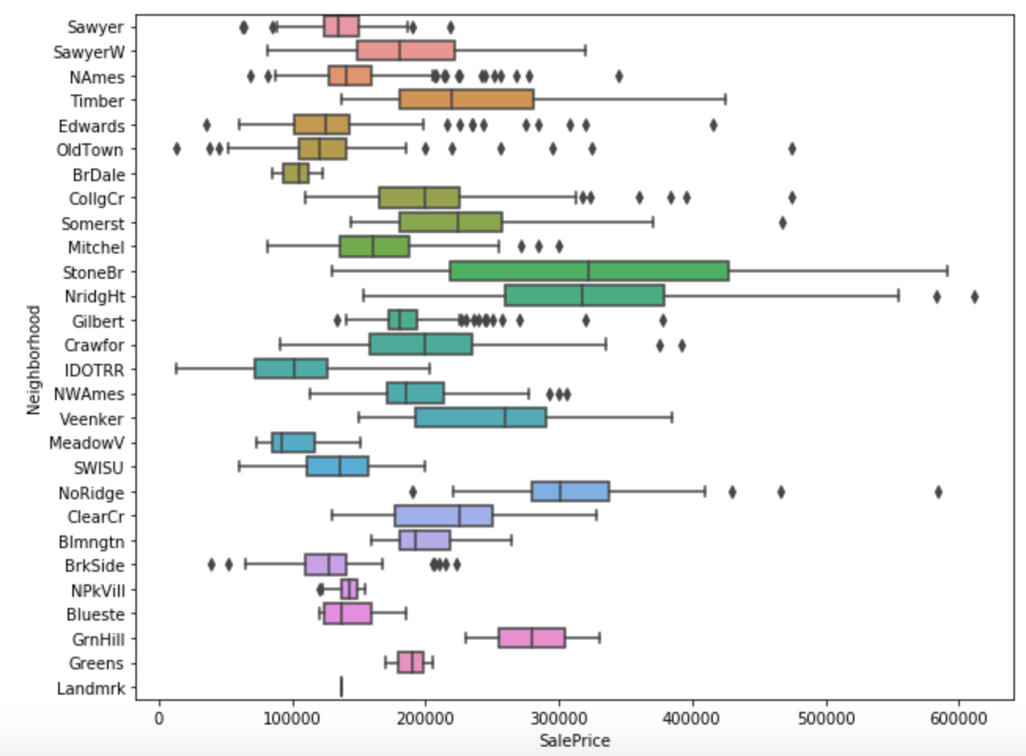
Methodology: Tried to make sense of location

Slide 6
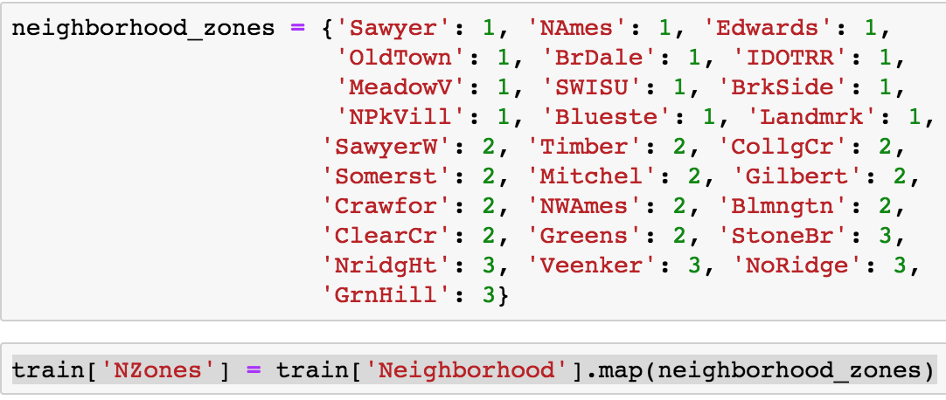
Building Neighborhood Groups

Slide 7
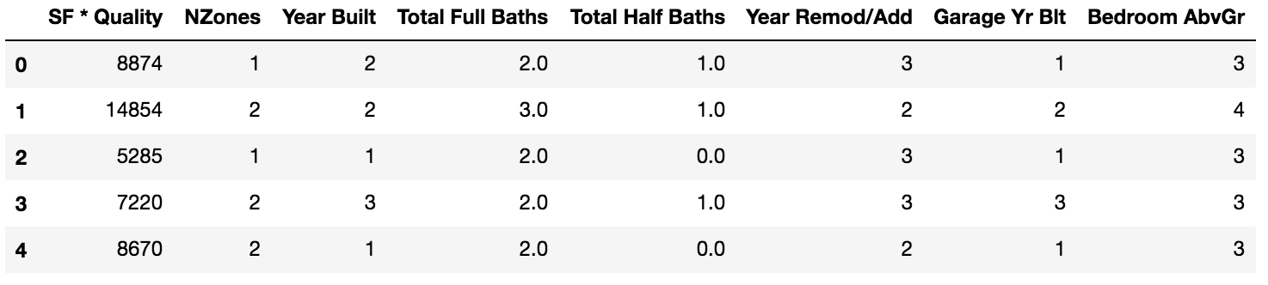
Best Model Features Used

Slide 8
Actual Values vs. Predicted values
Elastic Net:
Cross Val R^2 mean score: .809
Private RMSE: 30323.977
Public RMSE:
42181.513

Slide 9
Takeaways: What I would do differently
I would take the time to clean all of the data.
Once clean, I would use Lasso to pick my features rather than my own intuition
I would use WAY more visuals to gather more insight on the data.
Employ polynomial features

